Slide 1
Puzzle Platformer
Aaron Trevino, Daniel J. Sawtelle, Ping Hsu, Tyler LeDuc

Slide 2
End Product: Where is Mrs. Gumball
How to play
Use teleporters to move between levels.
Avoid spikes in levels, spikes do damage to your players health.
Gather power orbs, every 3 power orbs grants you 1 life.
When your power orbs are equal to 0 you die
End goal of game
Find Miss Gumball in one of the levels in the world

Slide 3
Design choices (slide 1)
World design
Our game has multiple worlds, in each world there are multiple levels
Levels have references to other levels allowing us to make a graph of levels which the MWorld class tracks.
Save design (Wow Factor)
Everything in the model implements Serializable, this allowed us to save that state of the world very accurately
At the initial start of the game, in the menu you can [Save Game], and [Load Game]. Saving a game makes a new file and writes all the Serializable state from the model. Loading a game loads a specific save file by reading the object.

Slide 4
Design choices (slide 2)
Multiple World design (Wow Factor)
Because our MWorld class is a graph of connected levels, is was easy to implement multiple worlds, by having a list of Mworlds that the player can move through after completing a world (finding Miss Gumball).
Each world is made by connecting levels together randomly, adding some variety to the game.

Slide 5
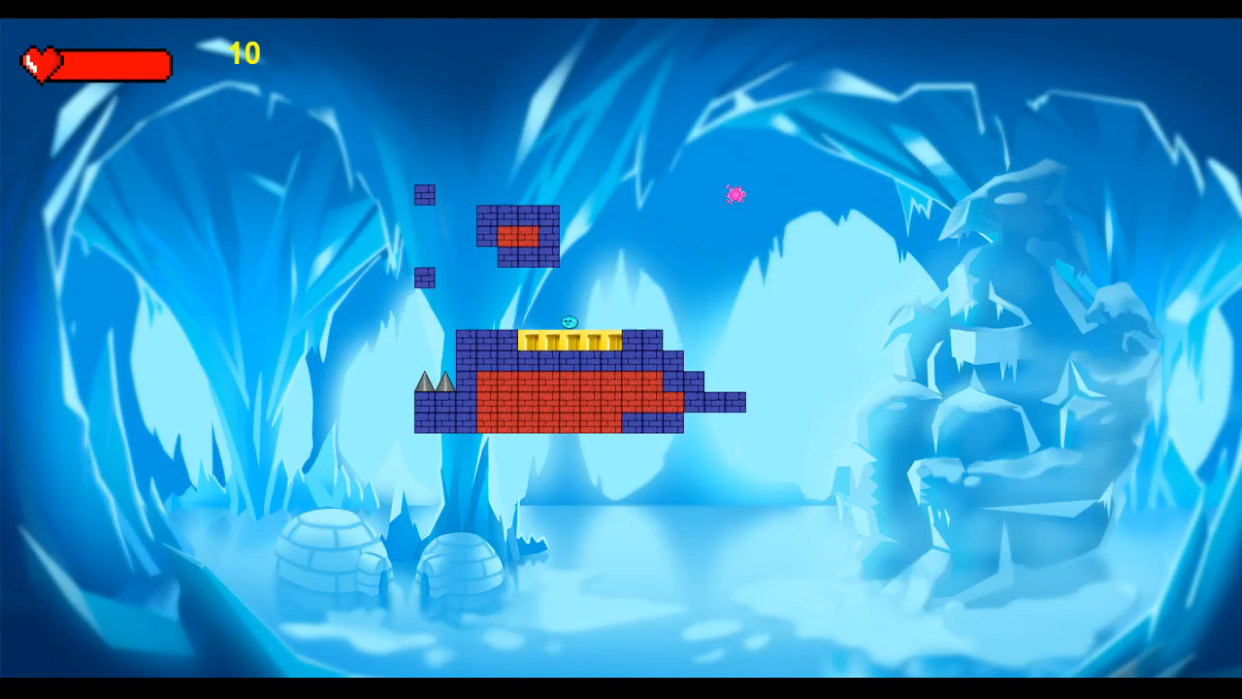
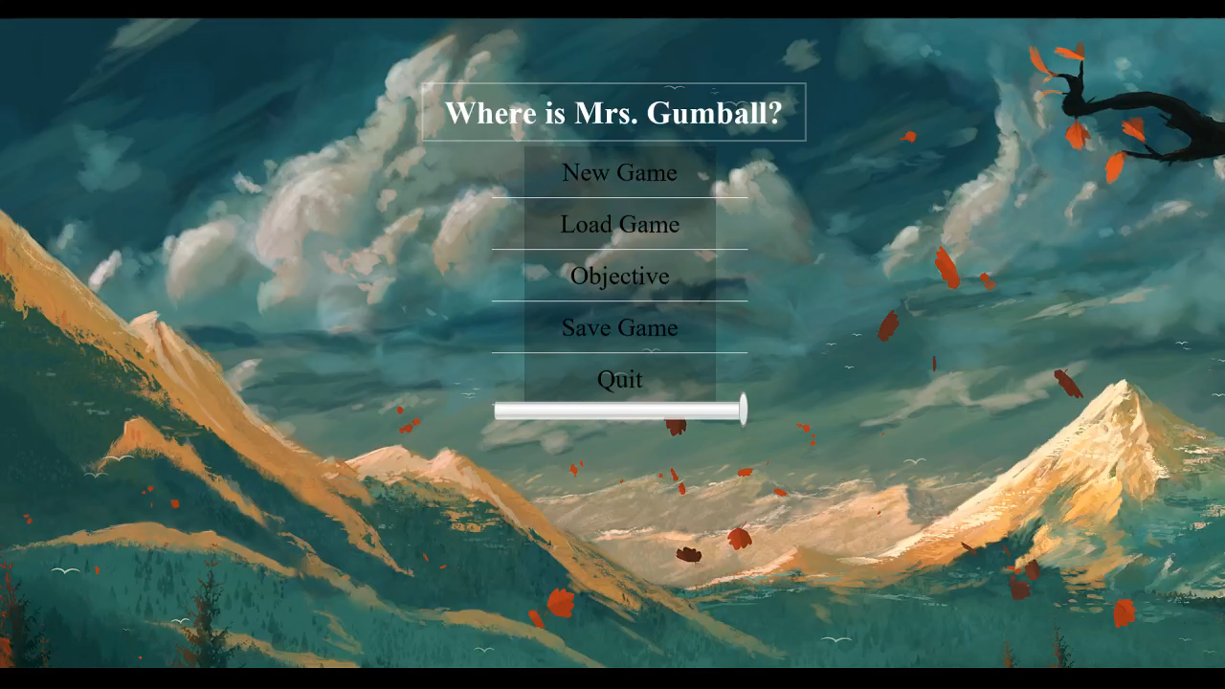
Video Examples (slide1)
Moving between levels
Finding Miss Gumball

Slide 6
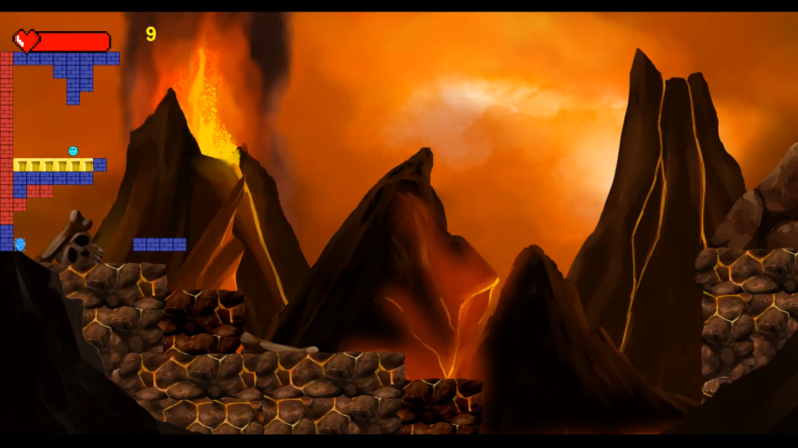
Video Examples (slide1)
Saving and Loading game

